Slide 1
Using Nelder-Mead Method to Optimize the Hyper-Parameters of a Quantum-Inspired Genetic Algorithm
Ayush Hariharan

Slide 2
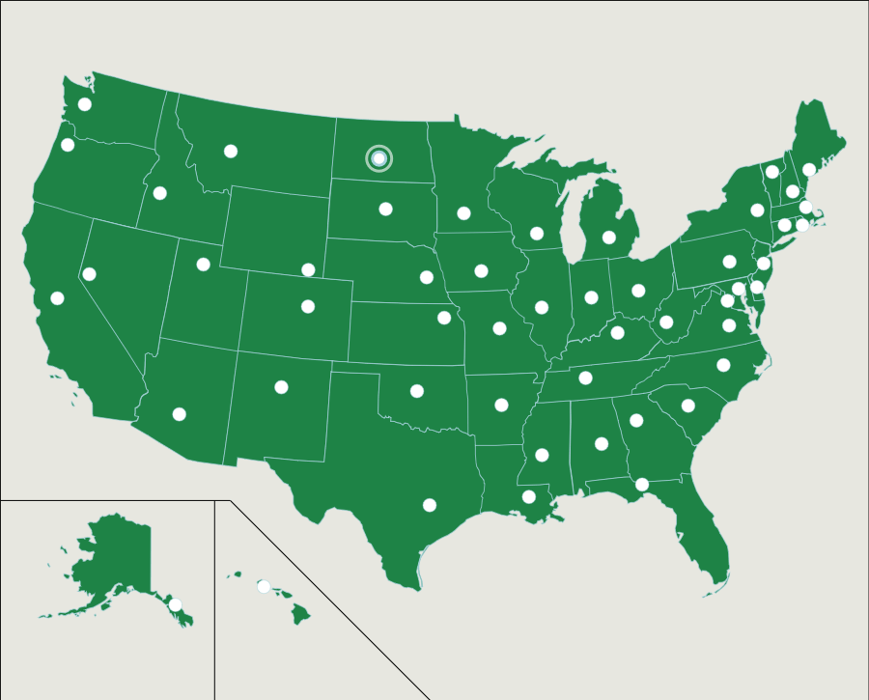
Road Trip of America!!
The U.S.: State Capitals. (2018). Online.seterra.com. Retrieved 7 December 2018, from https://online.seterra.com/en/vgp/3063

Slide 3
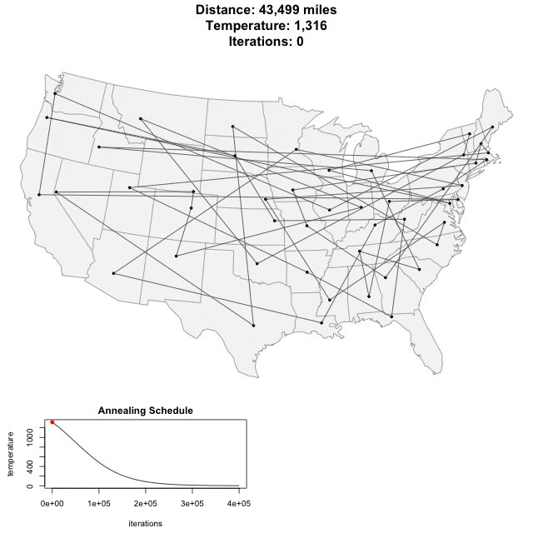
Traveling Salesman Problem
Schneider, T. (2014). The Traveling Salesman with Simulated Annealing, R, and Shiny. toddwschneider.com. Retrieved 5 December 2018, from http://toddwschneider.com/posts/traveling-salesman-with-simulated-annealing-r-and-shiny/

Slide 4
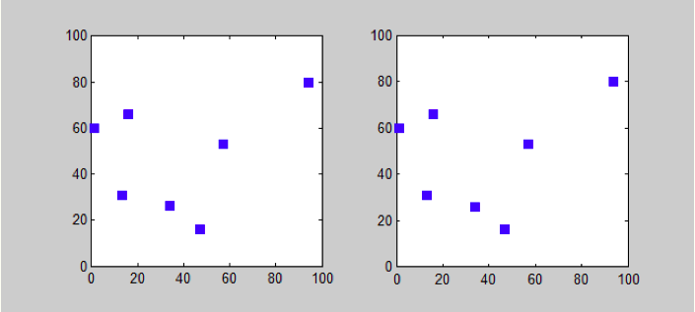
Classical Computing vs Quantum Computing
Woodward, A. (2018). Is It Quantum Computing or Not?. Scientific American Blog Network. Retrieved 5 December 2018, from blogs.scientificamerican.com/guest-blog/is-it-quantum-computing-or-not/

Slide 5
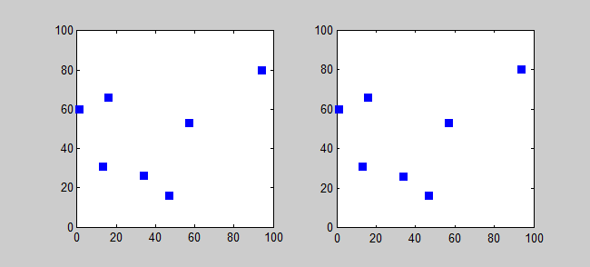
Classical Computing vs Quantum Computing
Woodward, A. (2018). Is It Quantum Computing or Not?. Scientific American Blog Network. Retrieved 5 December 2018, from blogs.scientificamerican.com/guest-blog/is-it-quantum-computing-or-not/

Slide 6
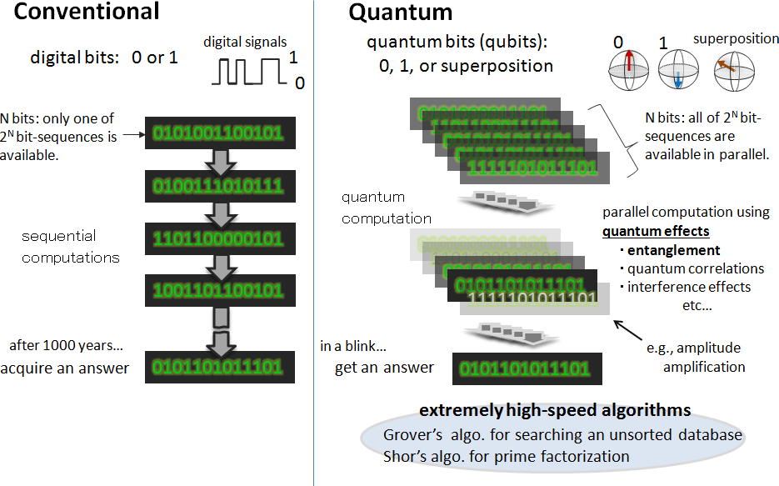
Why Is It Faster?
Entangling the atoms in an optical lattice for quantum computation. (2014). Phys.org. Retrieved 7 December 2018, from phys.org/news/2014-03-entangling-atoms-optical-lattice-quantum.html

Slide 7
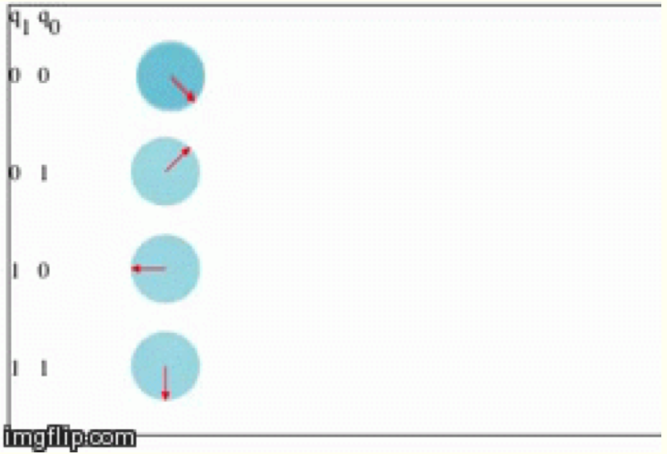
Fundamentals of Quantum Computing

Slide 8
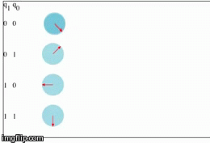
Fundamentals of Quantum Computing
Animated Qubits. (2018). Davidbkemp.github.io. Retrieved 7 December 2018, from http://davidbkemp.github.io/animated-qubits/

Slide 9
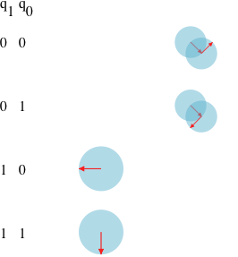
Fundamentals of Quantum Computing

Slide 10
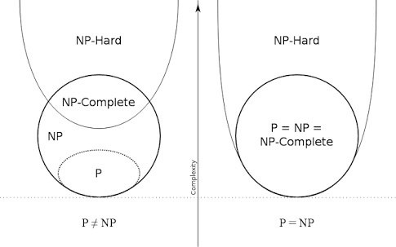
Np-Complete Problems
Kaplan, M. (2018). Can NP-Hard Be Verified in Polynomial Time. Quora, Retrieved 7 December 2018, from https://www.quora.com/Can-NP-hard-be-verified-in-polynomial-time

Slide 11
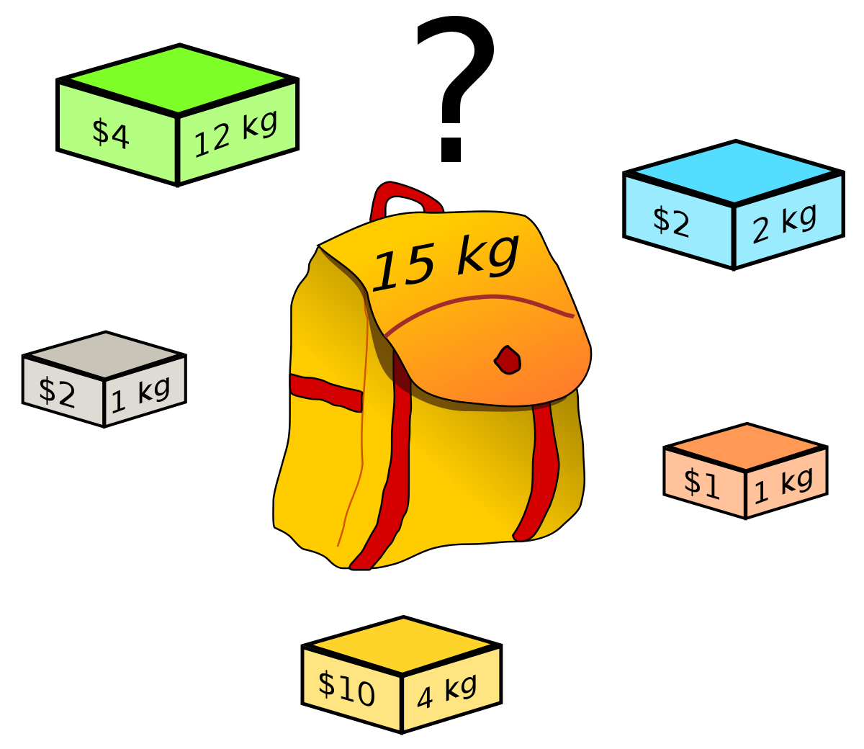
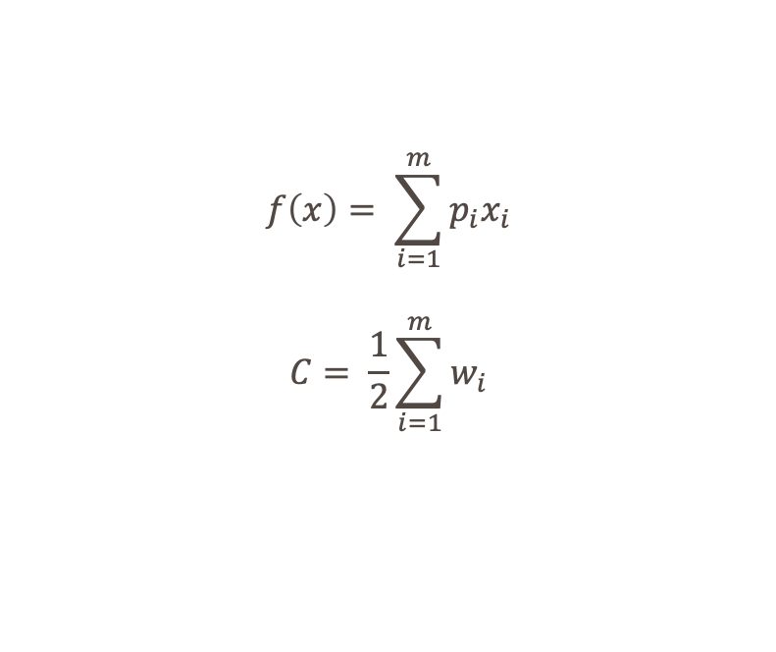
Knapsack Problem
$$f\left(x\right)= \sum_{i=1}^{m}{p_{i}x_{i}}$$
$$C= \frac{1}{2}\sum_{i=1}^{m}{w_{i}}$$
Knapsack problem. (2018). En.wikipedia.org. Retrieved 10 December 2018, from https://en.wikipedia.org/wiki/Knapsack_problem
Notes:
m = 250
w_{i} = a uniformly random number [1,10)
p_{i} = w_{i} + 5
x_{i} = a binary string from the Quantum Population

Slide 12
PHASE 1: Collecting Data Using the QIGA-2

Slide 13
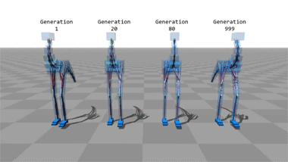
Genetic Algorithms
Computer simulations that teach themselves to walk.. (2014). Imgur. Retrieved 10 December 2018, from https://imgur.com/gallery/4zGWuki

Slide 14
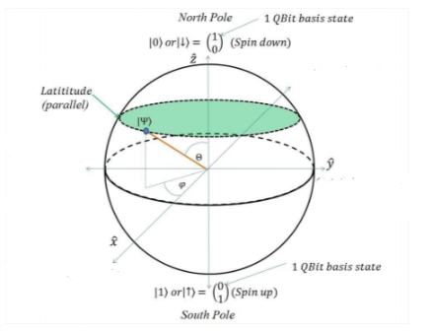
Dirac Notation
Mastriani, M. (2015, Dec). Quantum Image Processing? Quantum Information Processing, 16(1). doi: 10.1007/s11128-016-1457-y

Slide 15
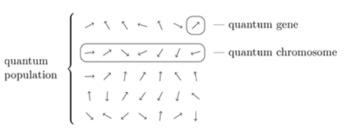
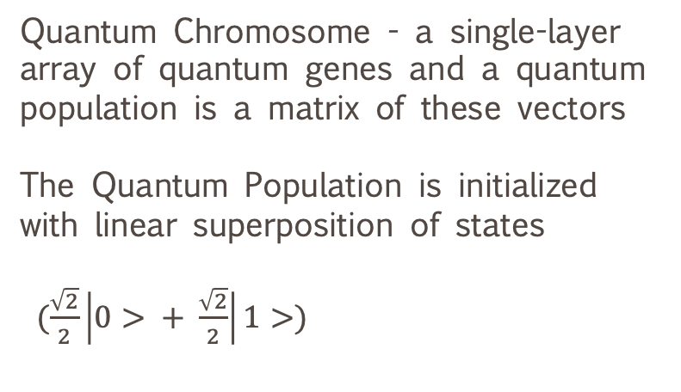
Step 1: Initialize Quantum Population
Quantum Chromosome - a single-layer array of quantum genes and a quantum population is a matrix of these vectors
The Quantum Population is initialized with linear superposition of states
$(\frac{\sqrt{2}}{2}\left|0> + \frac{\sqrt{2}}{2}\right|1>)$
Nowotniak, R. & Kucharski, J. (2010, July). Building Blocks Propagation in Quantum-Inspired Genetic Algorithms. Scientific Bulletin of Academy of Science and Technology.

Slide 16
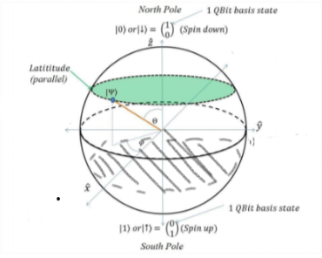
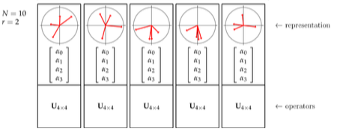
Step 2: Group Qubit Vectors into Registers
Quantum Register – an array consisting of multiple qubits
In this step, the individual qubits in the quantum chromosome are grouped together into 2-qubit quantum registers
In each register, both the qubit vectors are represented on the same Bloch sphere
Nowotniak, R. & Kucharski, J. (2014, Jul). Higher-Order Quantum-Inspired Genetic Algorithms. IEEE 2014 Federated Conference on Computer Science and Information Systems, doi: 10.15439/2014F99

Slide 17
Step 3: Measurement of the Population
Dür, W. & Heusler, S. (2013, Dec). What We Can Learn About Quantum Physics from a Single Qubit. The Net Advance of Physics.

Slide 18
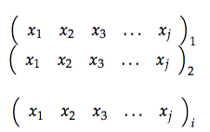
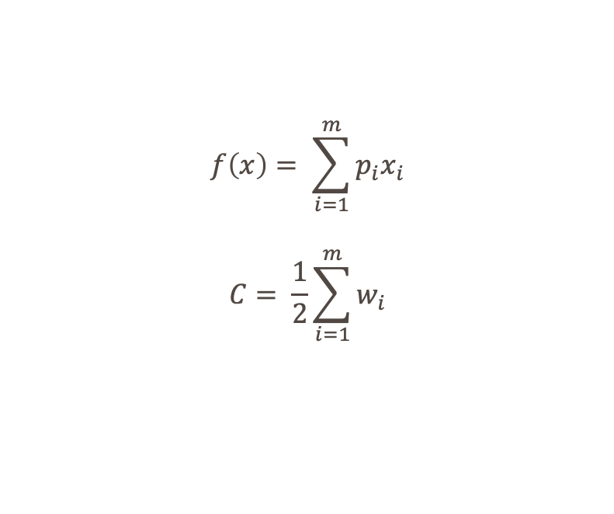
Step 4: Evaluation of the Population
After measurement, a population, P(t), is obtained composed of classical chromosomes or bit strings.
These strings are then evaluated in the knapsack function to determine which string provides the greatest profit and that string is stored as b.
$$f\left(x\right)= \sum_{i=1}^{m}{p_{i}x_{i}}$$
$$C= \frac{1}{2}\sum_{i=1}^{m}{w_{i}}$$
Lahoz-Beltra, R. (2016, Oct). Quantum Genetic Algorithms for Computer Scientists. MDPI, 5(4), 24. https://doi.org/10.3390/computers5040024
C++ Data Structures and Algorithms. (2018). O’Reilly | Safari. Retrieved 10 December 2018, from https://www.oreilly.com/library/view/c-data-structures/9781788835213/e590fee0-6802-4c04-a2e4-b6a0d3542912.xhtml

Slide 19
Probability Amplitudes
Gyongyosi, L. & Sandor, M. (2011, Apr). Quantum Cellular Automata Controlled Self-Organizing Networks. Cellular Automata - Innovative Modeling for Science and Engineering. doi: 10.5772/15750

Slide 20
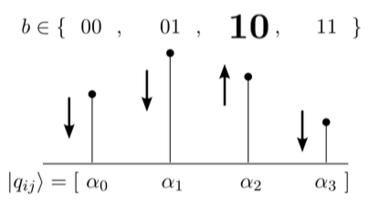
Step 5: Manipulating Amplitudes
After b is determined for the evolution, the amplitudes of each register are updated.
If the amplitude does not correspond to the j^{th} pair of bits in b, the amplitude is decreased by a factor of µ (approximately 0.99)
b

Slide 21
Step 6: Rotation Hyper-Parameters
The vector of the newly manipulated qubit register will be determined
The rotation angle between this new vector and the vector of the original qubit register will be recorded
The rotation angle will be stored in a genetic operator and these rotation angles will be used later in the Nelder-Mead Method

Slide 22
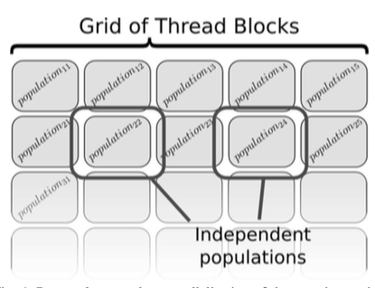
Step 7: Repeat
Steps 1– 6 will be repeated 500 times in order to optimize the profit from the knapsack problem
In order to make the execution of the algorithm more efficient, parallelization will be implemented
In a classical computer, the algorithm will be parallelized using different threads in the CUDA architecture

Slide 23
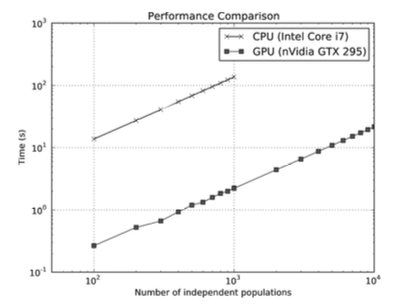
Step 8: Quantum Parallelization
However, IBM Qiskit has its own method of parallelization based upon the CUDA architecture
There are two types of parallel speedups available:
Multithreaded parallel evaluation of shots: Evaluating multiple “experiments” or quantum programs at the same time.
Multithreaded parallel update of the state vector for gates and measurements: Measuring the population and evaluating probability amplitudes at the same time.
IMPORTANT: The total number of threads used is always limited by the available number of CPU cores on a system
Notes:
Shots = number of times the experiment is run
State Vector = probability amplitude and measurements

Slide 24
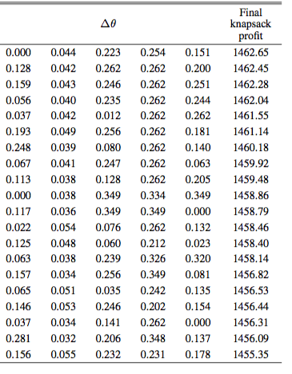
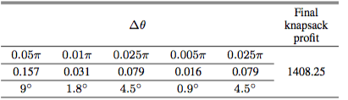
Step 9: Compiling Data
Rotation angles from each quantum population are compiled along with the final knapsack profit. NOTE: rotation angles after every 100 generations are recorded in the data table
The rotation angles from all of the quantum populations are then compiled along with the final knapsack profit

Slide 25
PHASE 2: Optimization of Hyper-Parameters using Nelder-Mead

Slide 26
Revisit Data
Before using the Nelder-Mead Method, a function needs to be obtained that will accurately model the data
What function can we use to model this data?
Data has 5 inputs (rotation values) and 1 output (knapsack profit), so a R₅ -> R₁ function will accurately map this data

Slide 27
Step 1: Weka Regression
Currently, the rotation values for the QIGA has no known pattern so visualization tactics will be used to find a pattern
This will be done in 3 steps:
View compiled data in WEKA
Apply Various Regression Techniques including
Linear
Exponential
Logistical
Determine which model best fits the data of rotation values and knapsack profit
Brownlee, J. (2016). How To Use Regression Machine Learning Algorithms in Weka. Machine Learning Mastery. Retrieved 10 December 2018, from https://machinelearningmastery.com/use-regression-machine-learning-algorithms-weka/

Slide 28
Step 2: TensorFlow Regression
Now that a pattern can be discerned, TensorFlow regression will be used to obtain a function (either linear, exponential, or logarithmic)
The function obtained from the TensorFlow Regression will be used in the Nelder-Mead method
In this case, the data will be plotted in a 6-dimensional space and the regression will occur in that space.
Khor, S.H. (2016) Gentlest Intro to TensorFlow #3: Matrices & Multi-feature Linear Regression. Medium. Retrieved 10 December 2018, from https://medium.com/all-of-us-are-belong-to-machines/gentlest-intro-to-tensorflow-part-3-matrices-multi-feature-linear-regression-30a81ebaaa6c

Slide 29
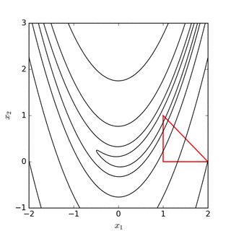
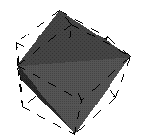
Step 4: Nelder-Mead Method – Initialization
Now that a function has been obtained, the Nelder-Mead method will be applied to that function in order to find the hyper-parameters that maximize the profit
In general, a Nelder-Mead is a simplex method for finding the local minimum or maximum of a function
NOTE: The shape of the simplex depends on the number of dimensions. A simplex of dimension m is a convex hull of an affinely independent set of points Y = {y⁰,y¹,...,y^{m}}.
0-d
1-d
2-d
3-d
4-d

Slide 30
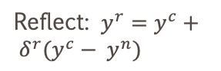
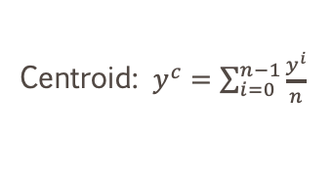
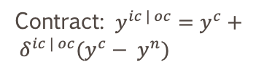
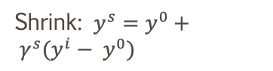
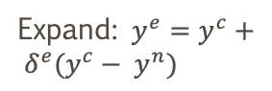
Step 5: Nelder-Mead Method – Manipulation
Reflect: $y^{r}=y^{c}+ δ^{r}(y^{c}− y^{n})$
Centroid: $y^{c}=\sum_{i=0}^{n−1}{\frac{y^{i}}{n}}$
Contract: $y^{ic | oc}=y^{c}+ δ^{ic | oc}(y^{c}− y^{n})$
Expand: $y^{e}=y^{c}+ δ^{e}(y^{c}− y^{n})$
Shrink: $y^{s}=y^{0}+ γ^{s}(y^{i}− y^{0})$

Slide 31
PHASE 3: Testing Optimized Hyper-Parameters using QIGA-2

Slide 32
Testing Nelder-Mead Optimization
Repeat same QIGA-2 Algorithm used in Phase I
EXCEPT: Instead of manipulating the amplitudes, rotate the qubit vectors by the hyper-parameter values

